Slide 1
HX TGW100 Transportable Gateway
The HX TGW100 Transportable Gateway is designed and optimized for smaller, rapidly deployable networks where provisioning high-quality, high-bandwidth links is critical. Fully compatible with the advanced HX System family, the HX TGW100 employs flexible and efficient satellite broadband technology to support a wide range of commercial and government applications.
ACTUAL EQUIPMENT BEING OFFERED WILL PROBABLY BE DIFFERENT

Slide 2
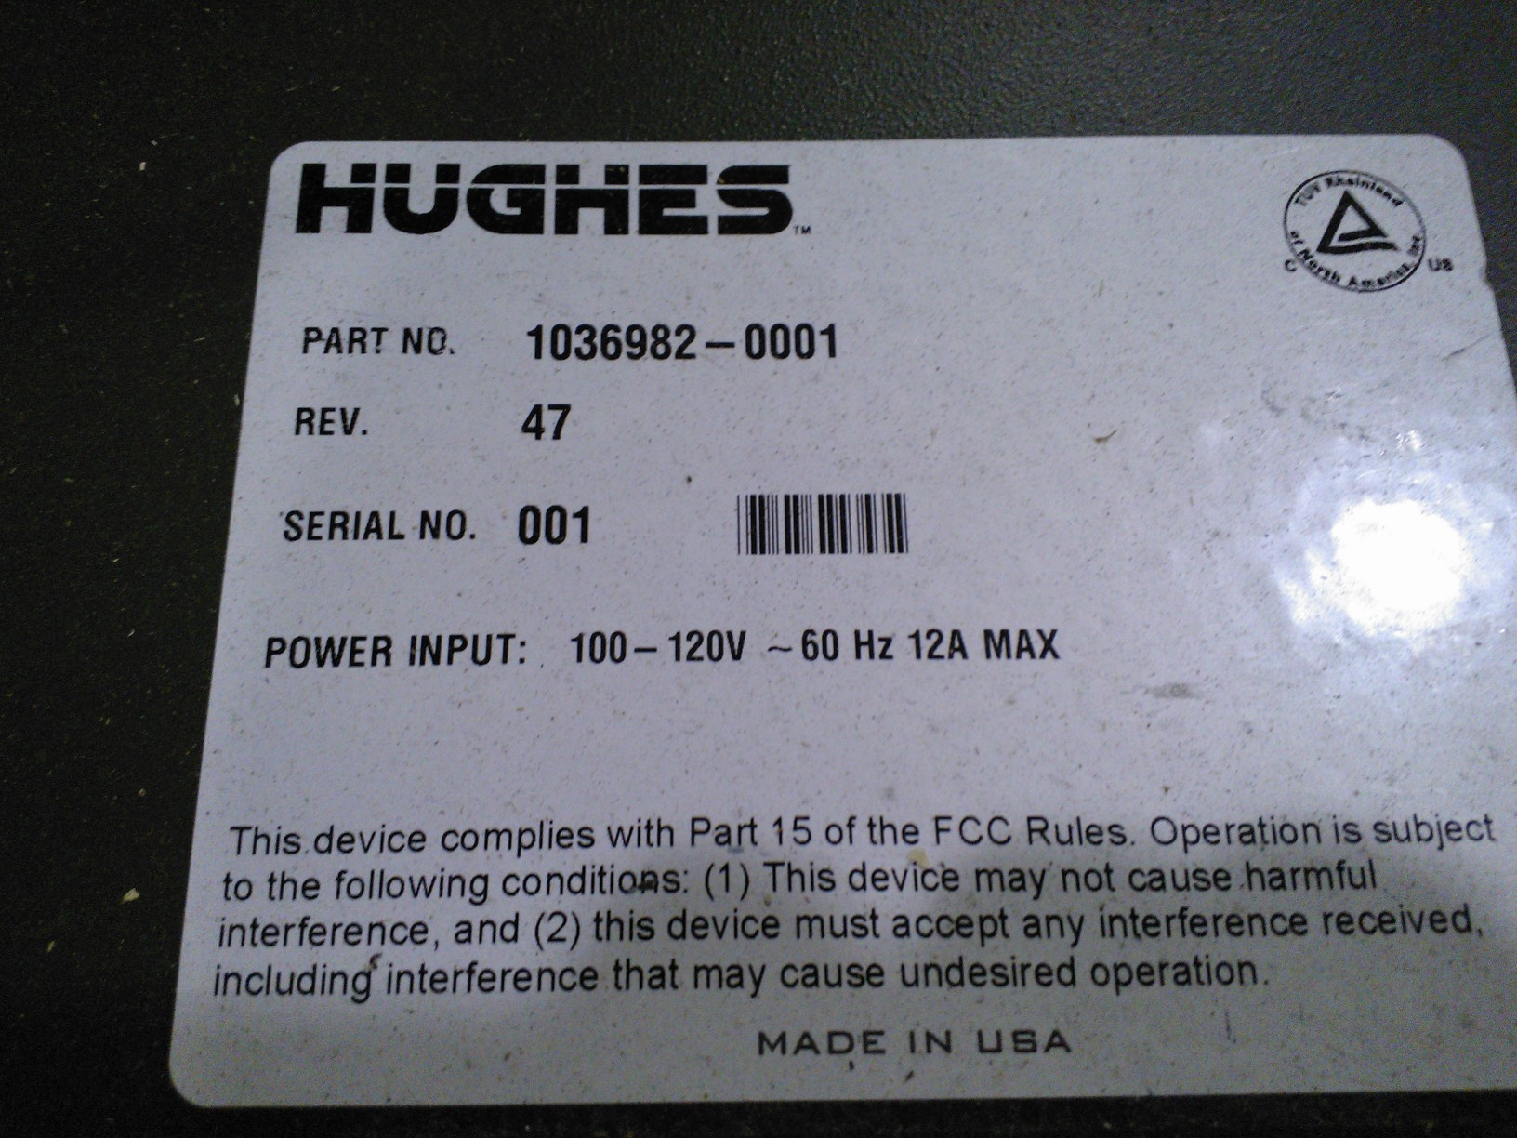
Hughes Transportable Gateway P/N 1036982-001
ACTUAL EQUIPMENT BEING OFFERED

Slide 3
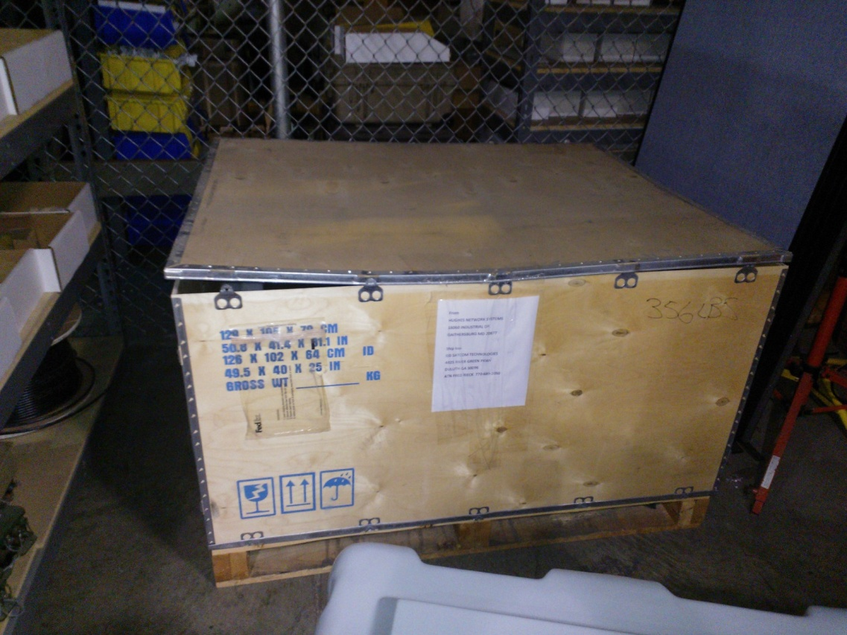
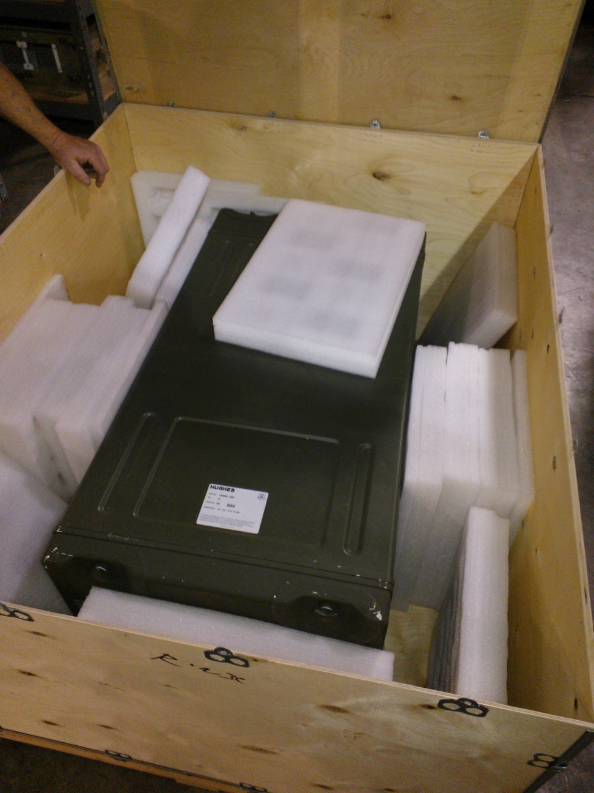
Contact:
Sean Thomas
Satellite Broadband Communications, Inc
Sean@SatBBC.com
(954) 283-9335
ACTUAL EQUIPMENT BEING OFFERED

Slide 5
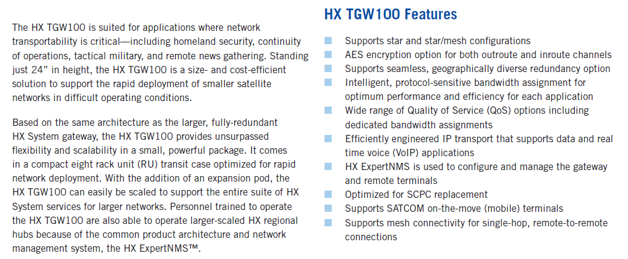

Slide 6
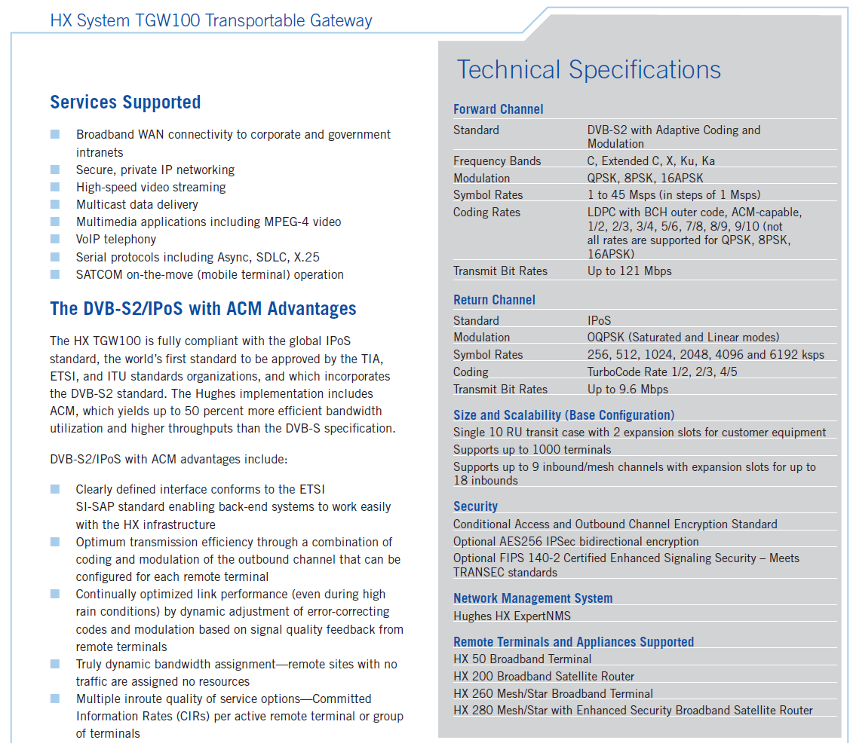

Slide 7
DISCLAIMER
The preceding descriptions and specifications are for current production versions and the unit being offered may need updates and/or upgrades to operate with current production receivers/modems/routers or to meet the listed specifications.
This is an “AS-IS” sale, there is no warranty and no expectation of performance.
Buyer assumes all risk.

